Slide 1
Discrete Structure Implications and Biconditional Logic
Week 3
By
Dr. Rafiullah Khan

Slide 2
Implications (→)
Consider the statement:
"If you earn an A in Math, then I'll buy you a computer."
This statement is made up of two simpler statements:
p: "You earn an A in Math," and
q: "I will buy you a computer."
The original statement is then saying:
if p is true, then q is true, or, more simply, if p, then q.
We can also phrase this as p implies q, or simply p → q.

Slide 3
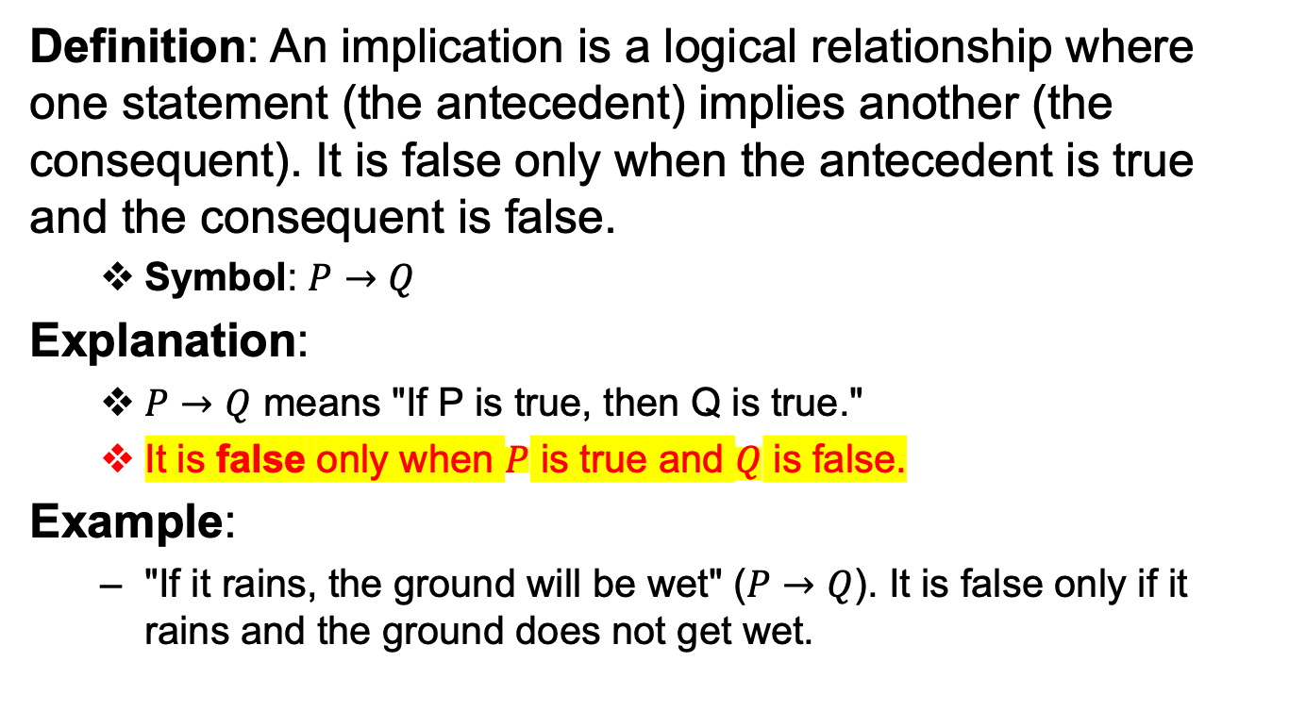
Implications (→)
Definition: An implication is a logical relationship where one statement (the antecedent) implies another (the consequent). It is false only when the antecedent is true and the consequent is false.
Symbol: $P→Q$
Explanation:
$P→Q$ means "If P is true, then Q is true."
It is false only when $P$ is true and $Q$ is false.
Example:
"If it rains, the ground will be wet" ($P→Q$). It is false only if it rains and the ground does not get wet.

Slide 4
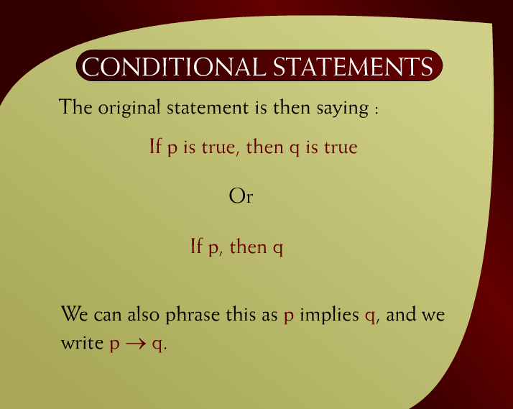
Conditional Statements – 6a

Slide 5
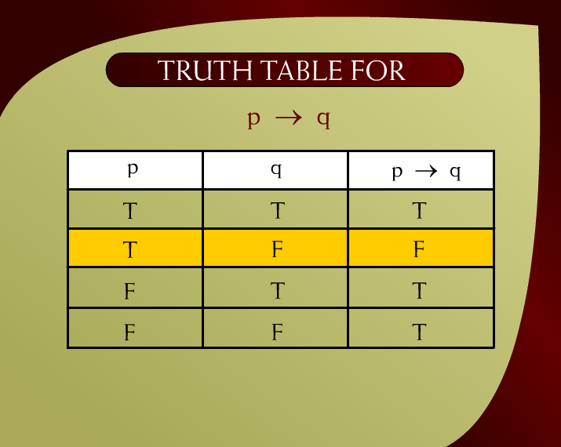
Truth Table for p → q - 8

Slide 6
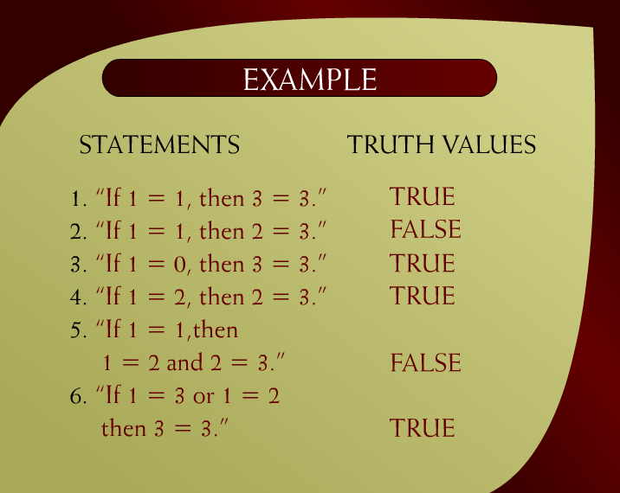
Example – 9

Slide 7
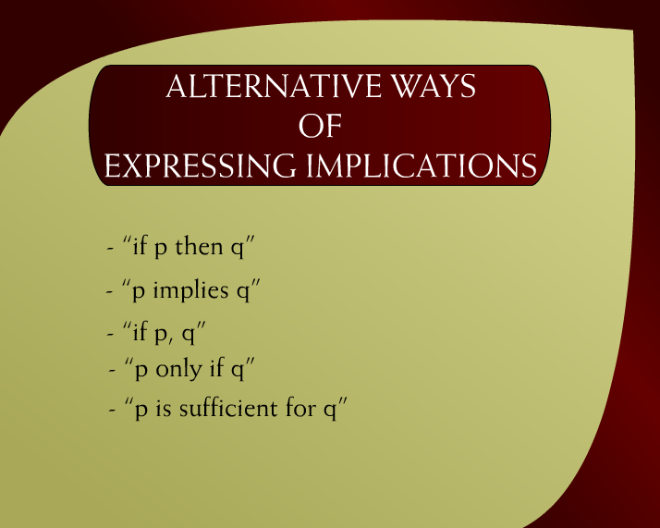
Alternative Ways of Expressing Implications – 10

Slide 8

Alternative Ways of Expressing Implications – 10a

Slide 9
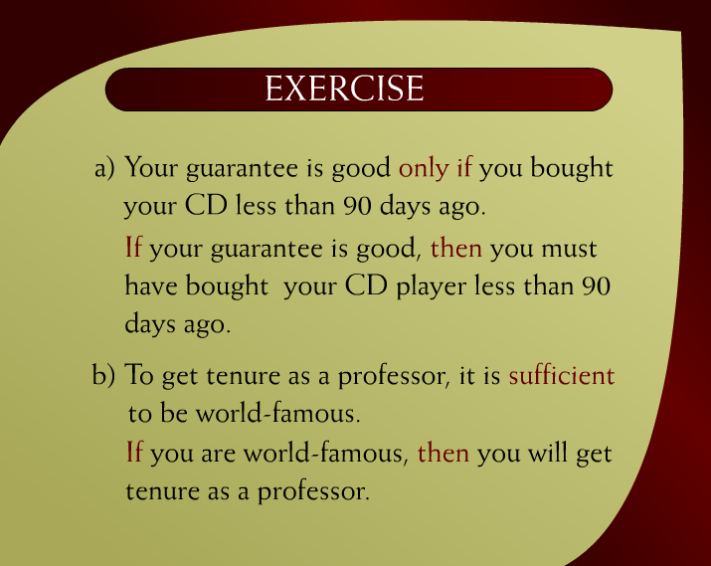
Exercise - 11

Slide 10
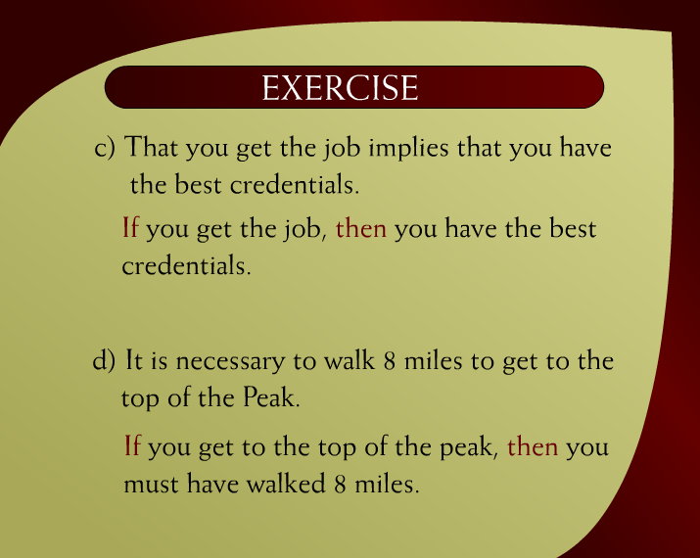
Exercise – 11a

Slide 11
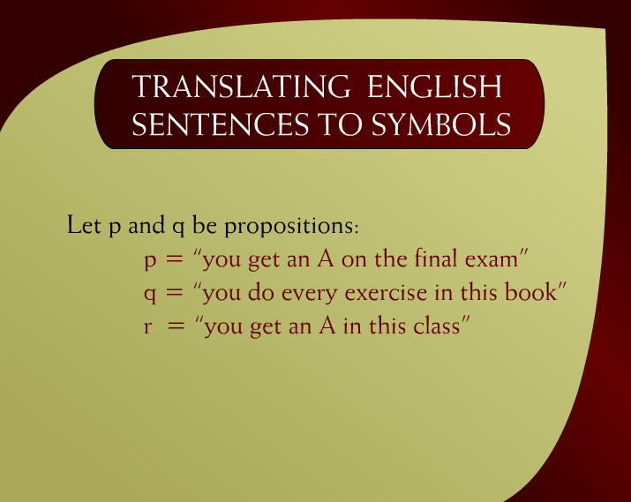
Translating English Sentences to Symbols - 12

Slide 12
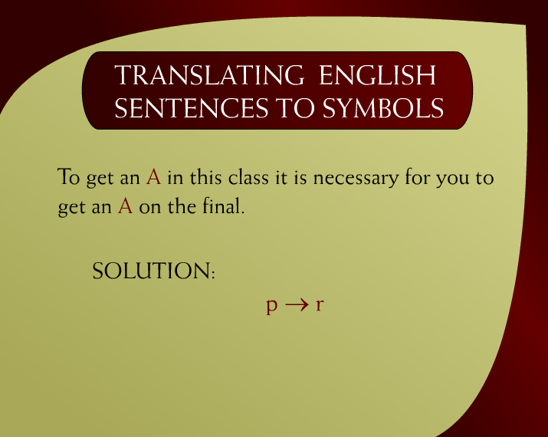
Translating English Sentences to Symbols – 12a

Slide 13
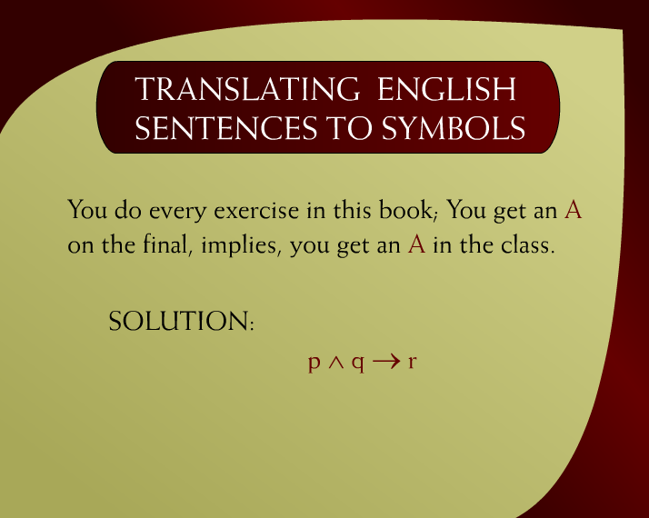
Translating English Sentences to Symbols – 12b

Slide 14
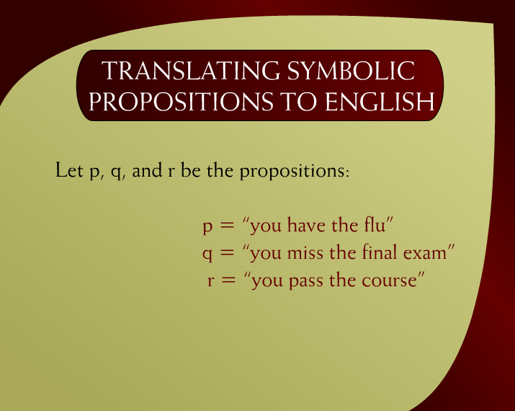
Translating Symbolic Propositions to English – 13

Slide 15

Translating Symbolic Propositions to English – 13a

Slide 16
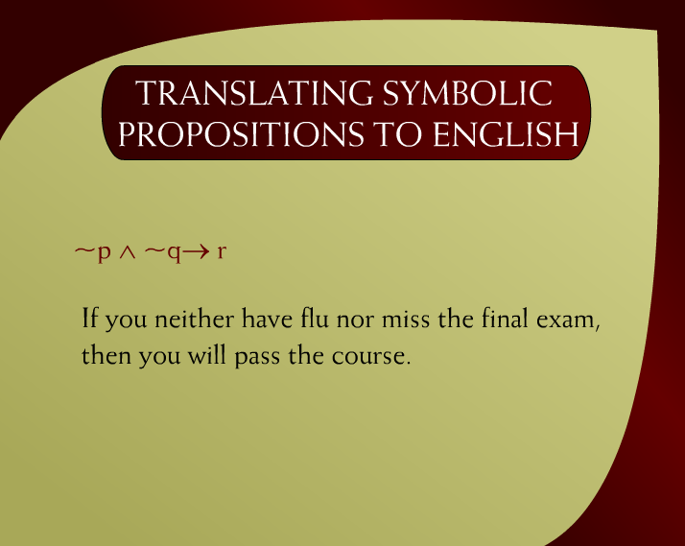
Translating Symbolic Propositions to English – 13b

Slide 17
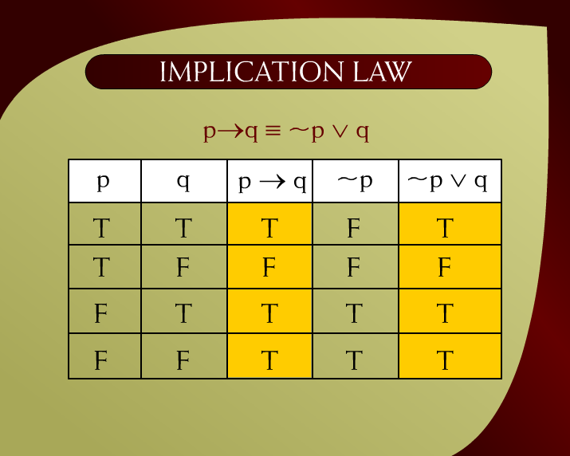
Implication Law – 23
Prove that
Using Truth Table

Slide 18
Implication Law – 23

Slide 19
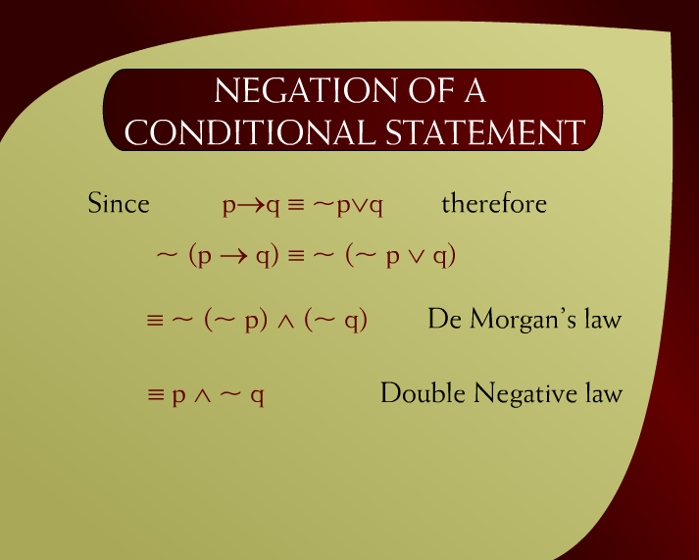
Negation of a Conditional Statement - 15

Slide 20
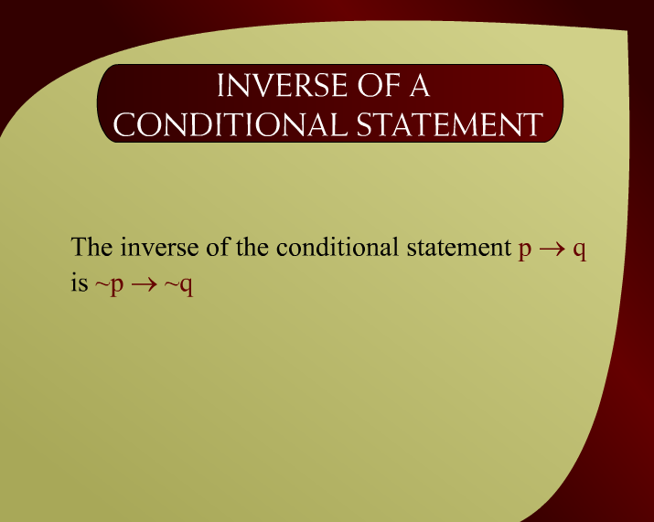
Inverse of a Conditional Statement - 24

Slide 21
Verify that
p →q = ~p → ~q
or
p →q ≠ ~p → ~q

Slide 22
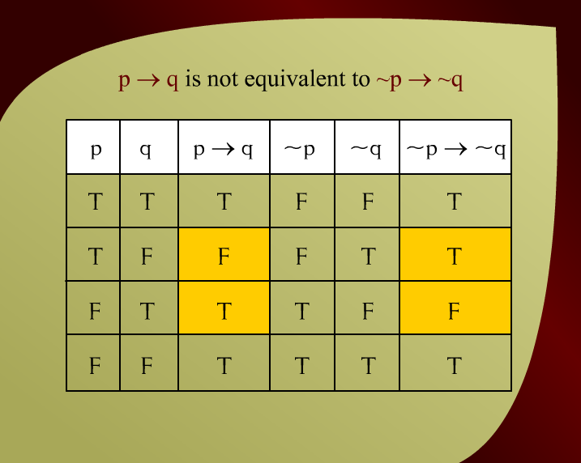
p → q is not equivalent to ~p → ~q – (3 – 25)

Slide 23
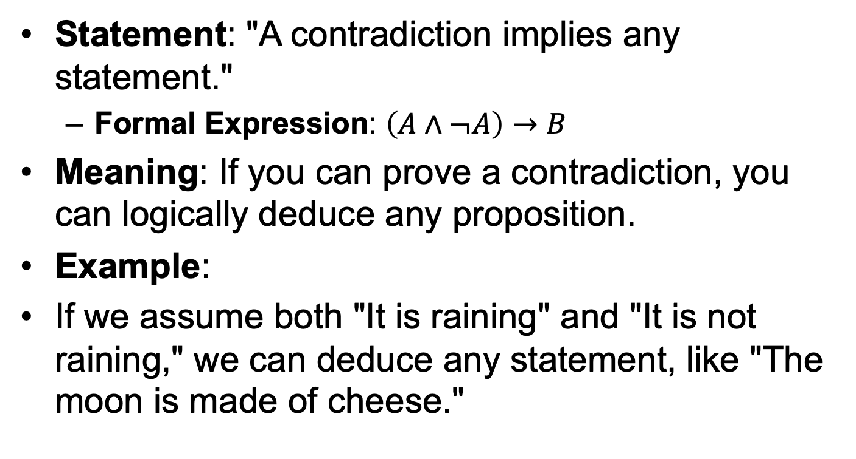
Law of Contradiction
Statement: "A contradiction implies any statement."
Formal Expression: $\left(A∧¬A\right)→B$
Meaning: If you can prove a contradiction, you can logically deduce any proposition.
Example:
If we assume both "It is raining" and "It is not raining," we can deduce any statement, like "The moon is made of cheese."

Slide 24
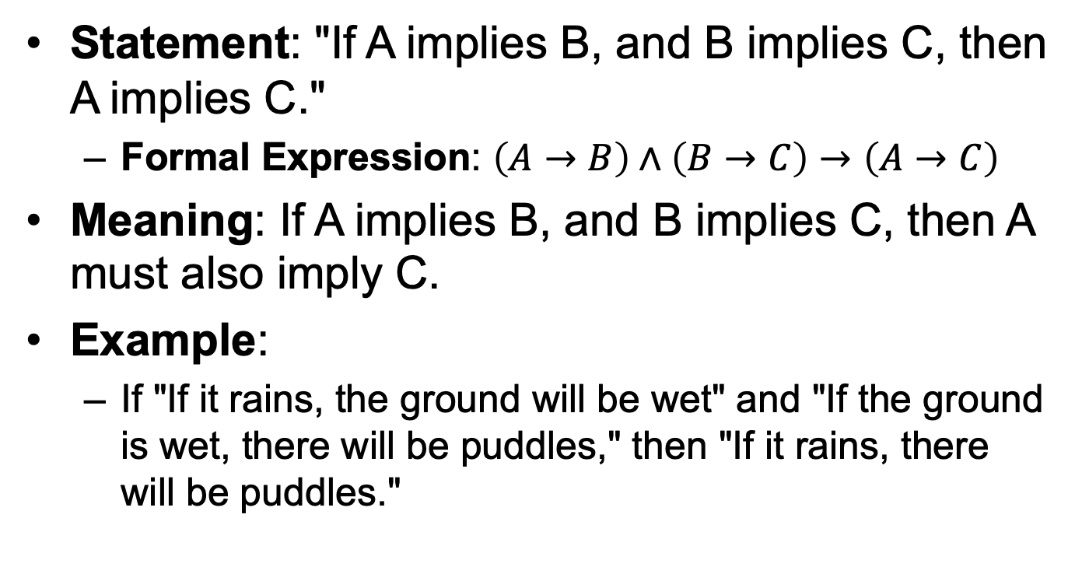
Law of Implication (Transitivity of Implication)
Statement: "If A implies B, and B implies C, then A implies C."
Formal Expression: $\left(A→B\right)∧\left(B→C\right)→\left(A→C\right)$
Meaning: If A implies B, and B implies C, then A must also imply C.
Example:
If "If it rains, the ground will be wet" and "If the ground is wet, there will be puddles," then "If it rains, there will be puddles."

Slide 25
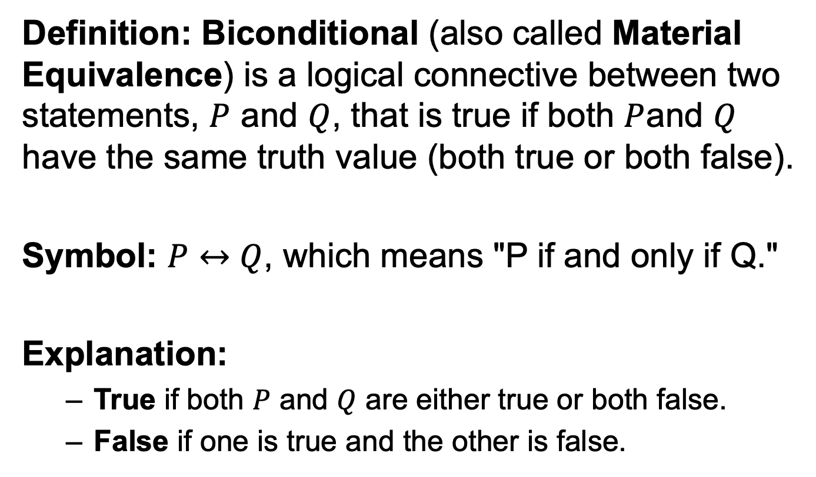
Biconditional Logic
Definition: Biconditional (also called Material Equivalence) is a logical connective between two statements, $P$ and $Q$, that is true if both $P$and $Q$ have the same truth value (both true or both false).
Symbol: $P↔Q$, which means "P if and only if Q."
Explanation:
True if both $P$ and $Q$ are either true or both false.
False if one is true and the other is false.

Slide 26
Biconditional Logic Examples
You can enter the party if and only if you have an invitation.
A number is even if and only if it is divisible by 2.”
The light is on if and only if the switch is up.

Slide 27
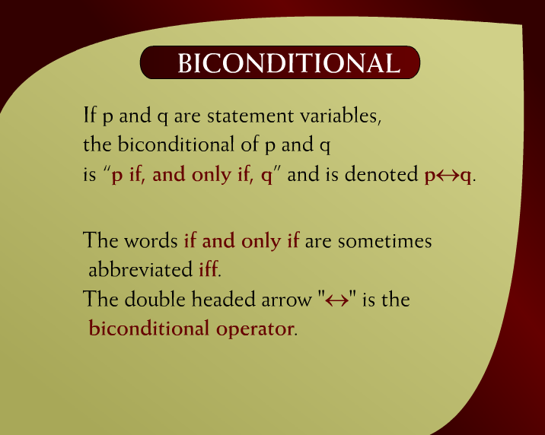
Biconditional - 2

Slide 28
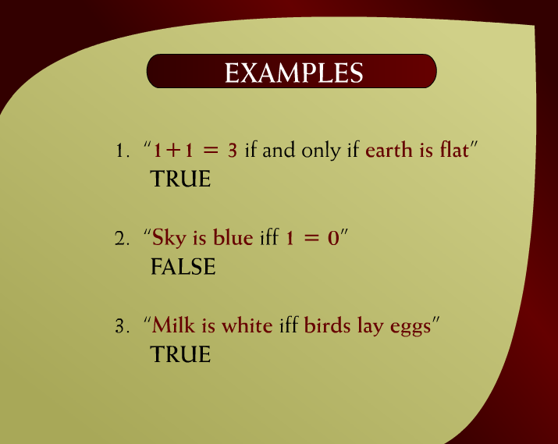
Examples – 4a

Slide 29
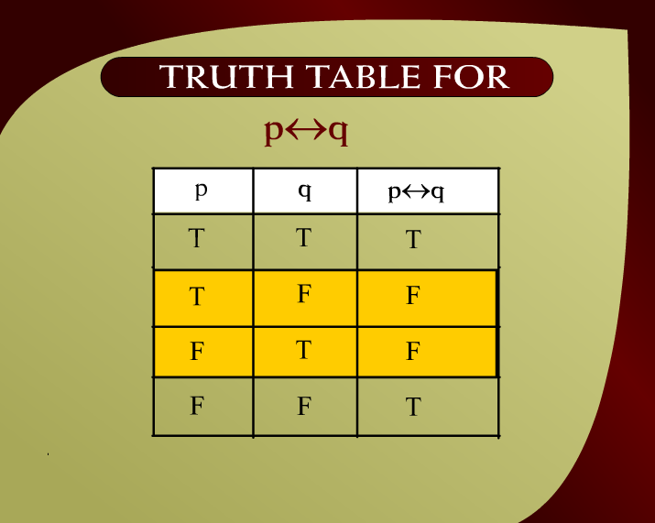
Truth Table for p <--> - 3

Slide 30
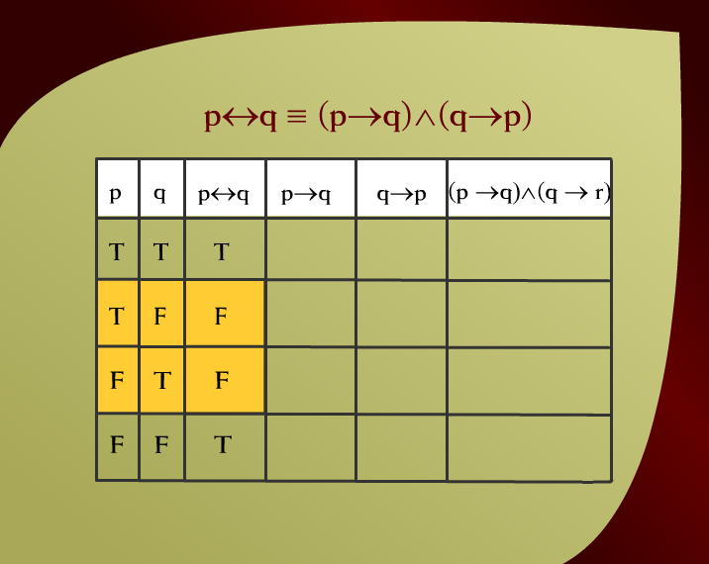
p q = (p q) (q p) – 5a
v

Slide 31
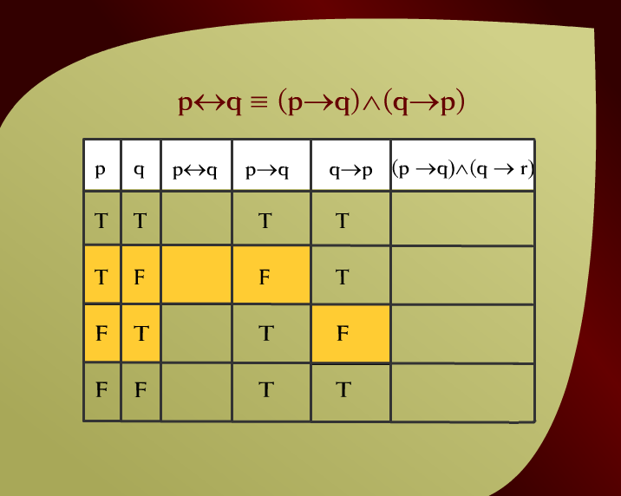
p q = (p q) (q p) – 5b
v

Slide 32
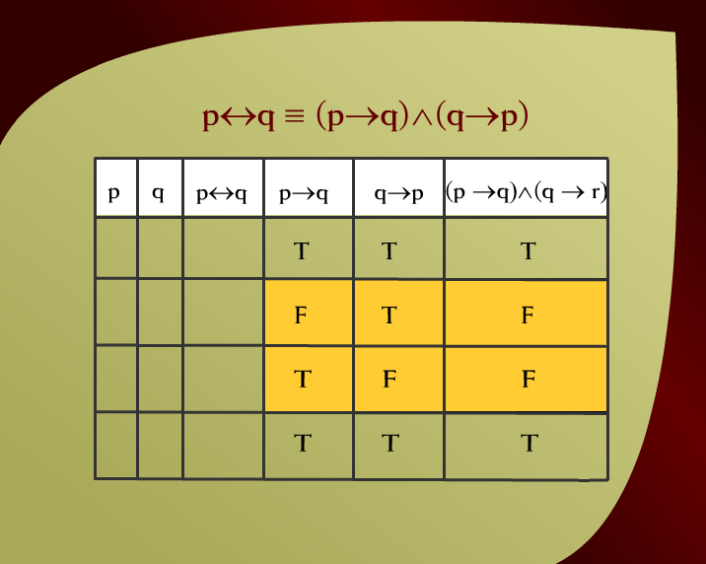
p q = (p q) (q p) – 5c
v
– 5c

Slide 33
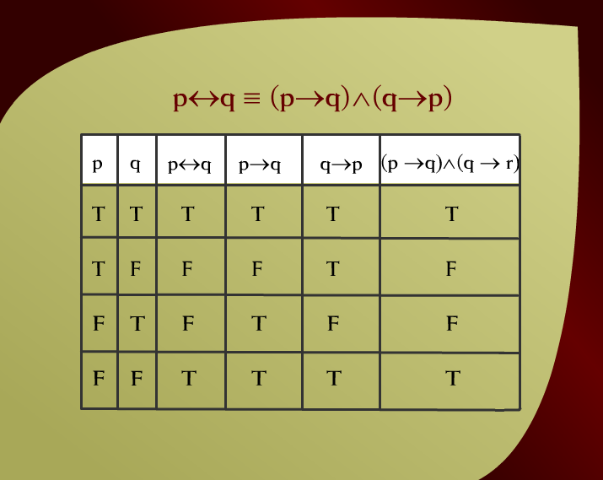
p q = (p q) (q p) – 5
v

Slide 34
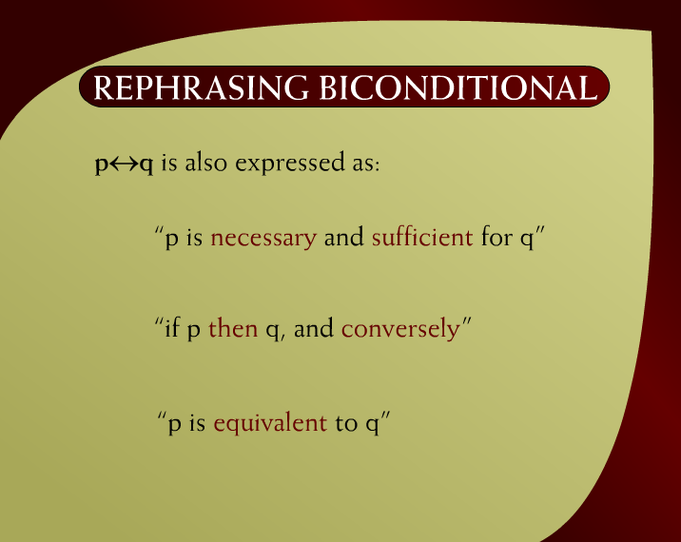
Rephrasing Biconditional - 6

Slide 35
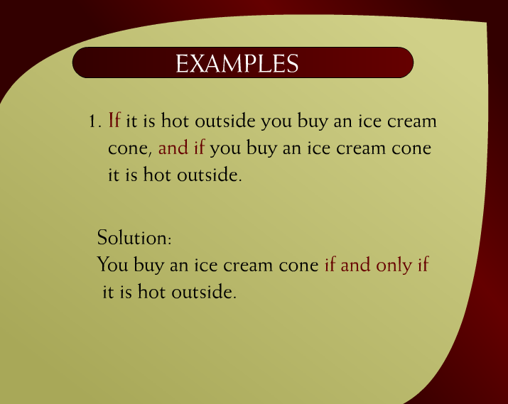
Examples – 9

Slide 36
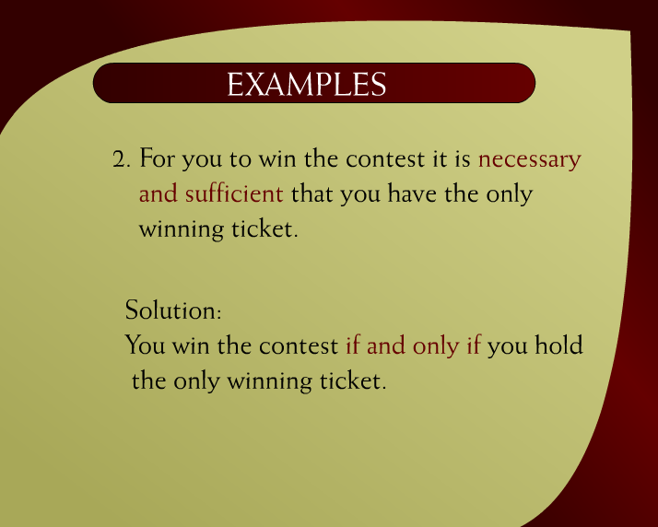
Examples – 9a

Slide 37
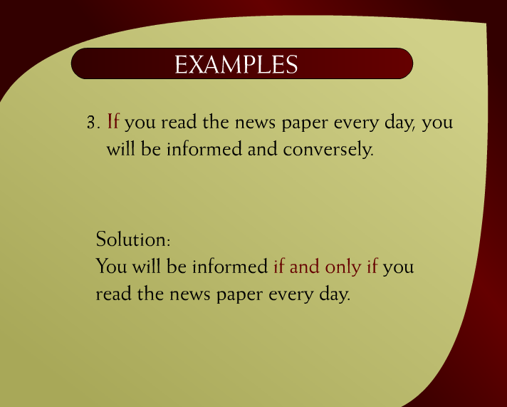
Examples – 9b

Slide 38
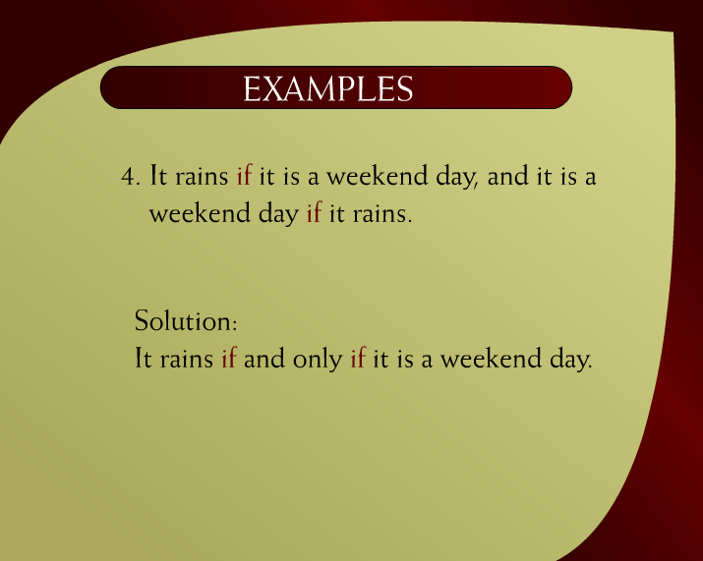
Examples – 9c

Slide 39
Show that ~p↔q and p↔~q are logically equivalent
p
q
~p
~q
~p↔q
p↔~q
T
T
F
F
F
F
T
F
F
T
T
T
F
T
T
F
T
T
F
F
T
T
F
F

Slide 40
Show that ~(p⊕q) and p↔q are logically equivalent
p
q
p⊕q
~(p⊕q)
p↔q
T
T
F
T
T
T
F
T
F
F
F
T
T
F
F
F
F
F
T
T

Slide 41
LAWS OF LOGIC
Commutative Law : p ↔ q ≡ q ↔ p
Implication Laws: p →q ≡ ~p ∨ q ≡ ~(p ∧ ~q)
Exportation Law: (p ∧ q)→r ≡ p →(q →r)
Equivalence: p ↔ q ≡ (p →q)∧(q →p)
Reductio ad absurdum: p →q ≡ (p ∧ ~q) → c

Slide 42
Show that ~(p→q) → p is a tautology
~(p→q) → p Given statement form
~[~(p ∧ ~q)] → p Implication law p→q ≡ ~(p ∧ ~q)
(p ∧ ~q) → p Double negation law
~(p ∧ ~q) ∨ p Implication law p→q ≡ ~p ∨ q
(~p ∨ q) ∨ p De Morgan’s law
(q ∨ ~p) ∨ p Commutative law of ∨
q ∨ (~p ∨ p) Associative law of ∨
q ∨ t Negation law
t Universal bound law

